Slide 1

Sviluppare Azure Web Apps
Andrea Dottor Microsoft MVP ASP.NET
@dottor

Slide 2

Chi sono
Andrea Dottor
Microsoft MVP ASP.NET
www.dottor.net
andrea@dottor.net
@dottor

Slide 3
Cosa vedremo oggi
Applicazione ASP.NET Core pubblicata su Azure
Uso dello Storage per il salvataggio di file
Uso di Azure WebJobs per le attività in background

Slide 4
ASP.NET Core
ASP.NET Core 1 rc1

Slide 5
ASP.NET Core 1
One of the key benefits of .NET Core is its portability. You can package and deploy the CoreCLR with your application, eliminating your application’s dependency on an installed version of .NET (e.g. .NET Framework on Windows). You can host multiple applications side-by-side using different versions of the CoreCLR, and upgrade them individually, rather than being forced to upgrade all of them simultaneously.
https://docs.asp.net/en/latest/conceptual-overview/dotnetcore.html
http://weblogs.asp.net/scottgu/introducing-asp-net-5

Slide 6
ASP.NET Core 1
New light-weight and modular HTTP request pipeline
Ability to host on IIS or self-host in your own process
Built on .NET Core, which supports true side-by-side app versioning
Ships entirely as NuGet packages
Integrated support for creating and using NuGet packages
Single aligned web stack for Web UI and Web APIs
Cloud-ready environment-based configuration
Built-in support for dependency injection
Build and run cross-platform ASP.NET apps on Windows, Mac and Linux

Slide 7
ASP.NET Core
Work with your favorite development tools
Visual Studio Code
Visual Studio Code is a cross-platform code editor refined and optimized for building modern web and cloud applications.
generator-aspnet
Yeoman is a scaffolding platform built on top of Node.js that allows you to build template-based generators for projects or code files. generator-aspnet is a yeoman generator that allows you to scaffold ASP.NET 5 applications.
OmniSharp
OmniSharp is a set of tooling, editor integrations and libraries for developing in .NET. OmniSharp works with a number of editors including Atom, Brackets, Emacs, Sublime Text and Vim.

Slide 8
ASP.NET Core
Benchmark
2300% request/s (servite) rispetto ad ASP.NET 4.6!
Superati 1.15 Milioni di request/s, 12.6 Gbps
In ASP.NET 5 RC rispetto la beta8, il tempo di risposta è passato da 20ms a 4ms

Slide 10
Azure App Service

Slide 11

Introducing Azure App Service
Unique integrated offering
Build rich, engaging & intelligent apps
Scale as your business grows
Azure Websites
Mobile Services
BizTalk Services

Slide 12
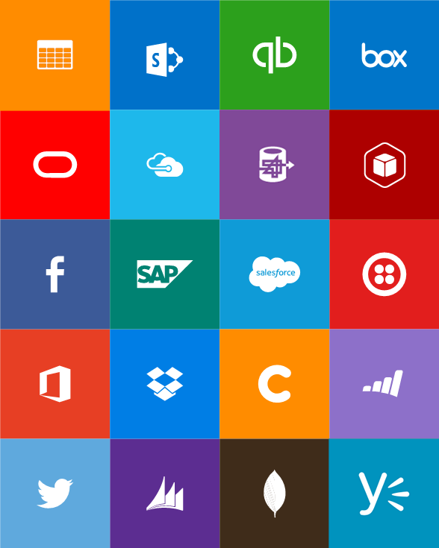


Slide 13
Azure App Service – One price
One price

Slide 14
Full capability set available including:
.NET, Node.js, Java, PHP, and Python
WebJobs for long running tasks
Integrated VS publish, remote debug…
CI with GitHub, BitBucket, VSO
Auto-load balance, Autoscale, Geo DR
Virtual networking and hybrid connections
Site slots for staged deployments
Web Apps
Web apps run as-is
no changes required

Slide 15
New capabilities for Mobile apps:
Webjobs for long running tasks
CI with GitHub, BitBucket, VSO
Auto-load balance, Autoscale, Geo DR
Virtual networking and hybrid connections
Site slots for staged deployments
Mobile Apps
Mobile services plus
a whole lot more

Slide 16
New Logic Apps for easy automation
No code designer for rapid creation
Dozens of pre-built templates to get started
Out of box support for popular SaaS and on-premises apps
Use with custom API apps of your own
Biztalk APIs for expert integration scenarios
LOGIC Apps
Automate SaaS and
on-premises systems

Slide 17

Easily use cloud or custom APIs:
Dozens of built-in APIs for popular SaaS
An ecosystem of APIs for any need
Create and publish custom, reusable APIs
Visual Studio tooling with one click publish and remote debugging
Automatic client SDK generation for many languages
Api Apps
Create, consume and
host APIs more easily

Slide 18
App Service - one integrated offering
Web Apps
Mobile Apps
Web apps that scale with your business
Build Mobile apps for any device
LOGIC Apps
API Apps
Automate business process across SaaS and on-premises
Easily build and consume APIs in the cloud

Slide 19



App Service - one integrated offering
Web Apps
Logic Apps
Mobile Apps
Administration App
Customer site
Customer Appointment
Customer App
API Apps
http
SQL

Slide 20
Azure App Service
Creare un'applicazione agganciata ad Azure App Service

Slide 21
Direttamente dalla creazione del progetto

Slide 22
Configurazione di Azure App Service

Slide 23
Pubblicazione da Visual Studio

Slide 24
Download profilo di pubblicazione
Dal portale di Azure è possibile scaricare il Profilo di configurazione da importare in Visual Studio
Contiene tutte le informazioni per eseguire la pubblicazione, compresa la password

Slide 25
Continous Delivery with App Service

Slide 26
Continuous integration

Slide 27

Continuous Deployment for Web Apps
Web App Production Slot
Auto-Swap
Hooks
Git pull
Commits
Changes
Web App Staging Slot
Source Control / Code Repo
Developer

Slide 28

Continuous Deployment
Non si è vincolati a pubblicare utilizzando (solo) tool di Microsoft
Continua ad utilizzare strumenti che già utilizzi:
Git
Visual Studio
Online
CodePlex
GitHub
BitBucket
DropBox
FTP

Slide 30
Scalabilità

Slide 31

Scalabilità automatica
Web App

Slide 32
Scalabilità automatica
Web App

Slide 33
Scalabilità automatica
Web App

Slide 34
Scalabilità
Scalabilità schedulata
Weekdays
Weekends
Week nights
Week mornings
Specific dates
Specific date ranges
Scalabilità manuale
Tramite il portale di Azure
Utilizzando gli Azure webhooks https://azure.microsoft.com/en-us/documentation/articles/automation-webhooks/
Utilizzando PowerShell https://blogs.technet.microsoft.com/heyscriptingguy/2015/10/28/use-powershell-to-scale-azure-websites/
Scalabilità automatica
Scale by metric (CPU o per numero di messaggi in una coda)

Slide 36
Azure Web Jobs

Slide 37






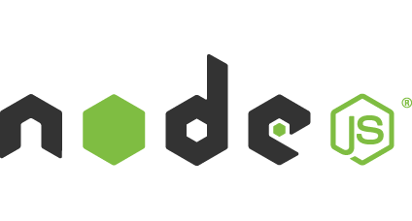
Azure Web Jobs
Pensati per eseguire operazioni lunghe o operazioni pianificate
Tipi di job: On-Demand, Scheduled, Continuous
Scalabilità: Singleton, Multi-instance
WebJobs SDK Feature: BlobTrigger, TableTrigger, QueueTrigger, ServicebusTrigger
Pubblicazione: Portal, Visual Studio, CLI, Git
run.cmd, run.bat
run.exe
run.ps1
run.sh
run.php
run.py
run.js

Slide 38
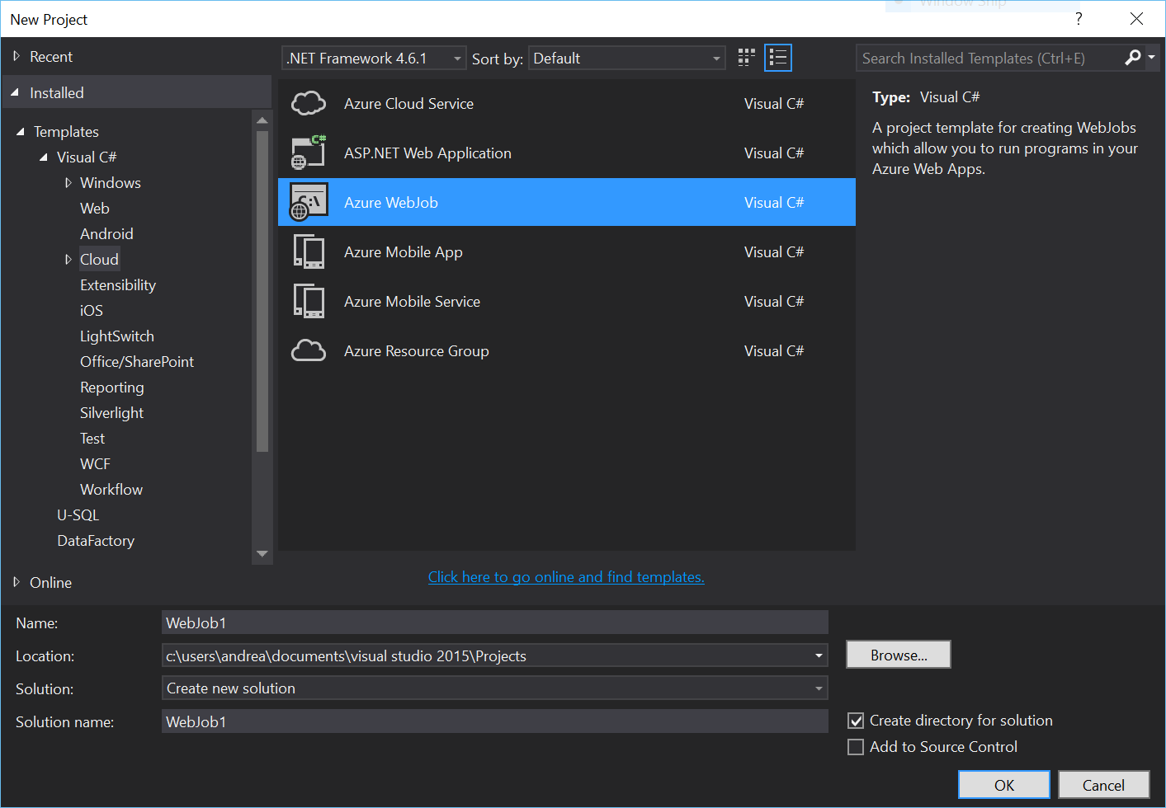
Creazione
Si possono creare direttamente da Visual Studio
Template di progetto Azure WebJob
Basati su una console application

Slide 39
Schedulazione
Continuativa
Schedulata

Slide 41
Remote debugging
E' possibile eseguire il debug di applicazioni pubblicate su Azure
Se dovete fare debug di ASP.NET Core:
Remote Debug ASP.NET Core RC1 on Azure App Service https://blogs.msdn.microsoft.com/webdev/2016/03/21/remote-debug-aspnet-core-on-azure/
Di default il debugger non si aggancia al processo del runtime di CoreCLR
Eseguire l'attach manuale al processo dnx.exe

Slide 42
Domande?

Slide 43
Chi sono
Andrea Dottor
Microsoft MVP ASP.NET
www.dottor.net
andrea@dottor.net
@dottor

